Slide 1
Big Project SekolahQA
Nafi Hermawan

Slide 2
Big Project
Introduction
Demo
Report

Slide 3
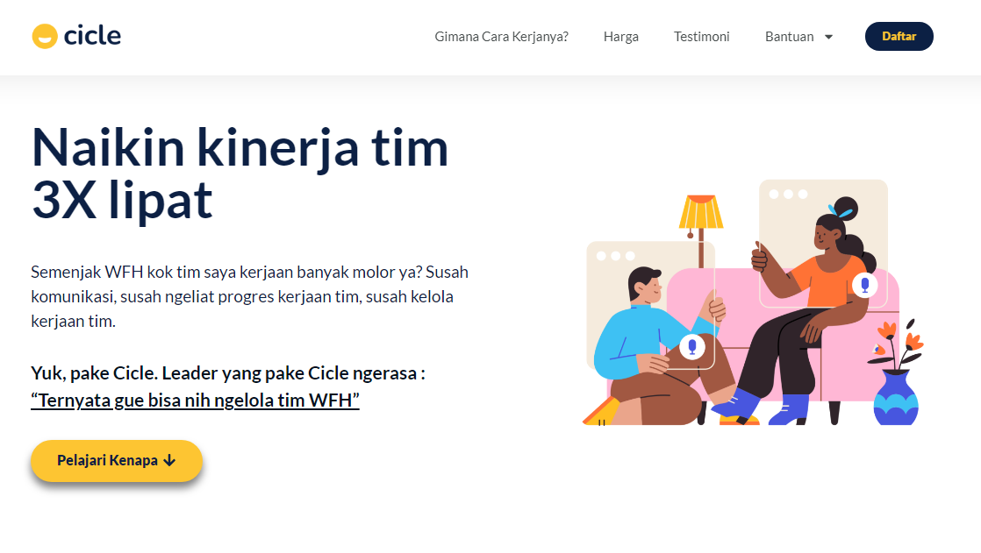
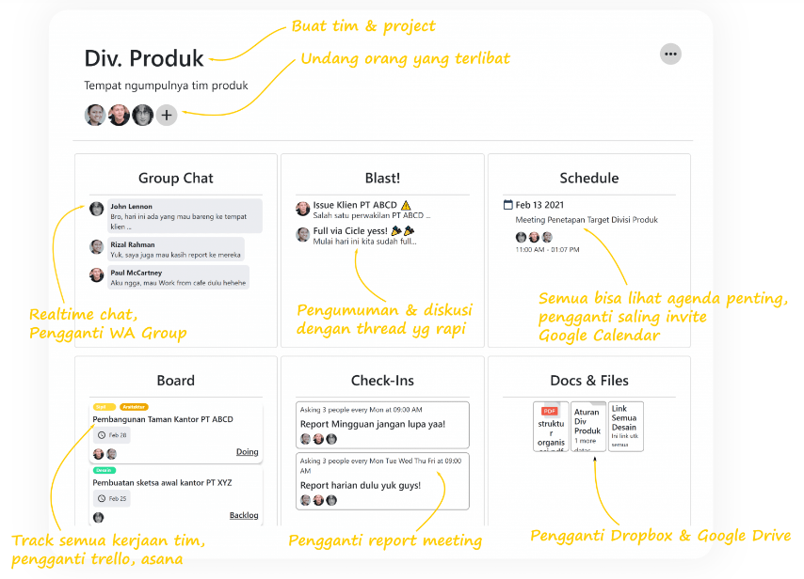

Slide 4
Non - Funcional Testing
Funcional Testing
Performance Testing
Manual Test
Automation Test

Slide 5
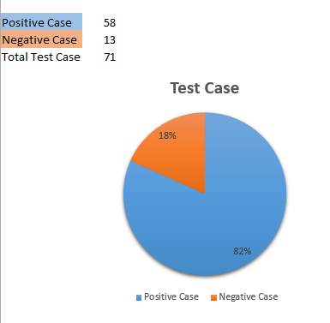
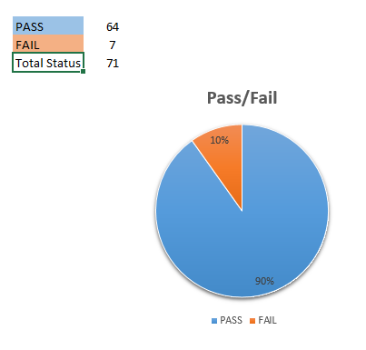

Slide 6
Report
Manual Report
Selenium Report
Jmeter Report

Slide 7
Terima kasih

